Slide 1
CRIMES IN INDIA
DSE 315 DATA SCIENCE PROJECT
Mrunal Pravin Kulkarni (22183)
Darshana Srivathsan (22001)
Prakash Kumbhakar (22241)

Slide 2
PROBLEM STATEMENT AND AIM
This project focuses on analyzing crime patterns in India using a comprehensive dataset covering various types of crimes, including theft, assault, and cybercrime, across states and Union Territories.
The dataset spans multiple years, enabling a detailed exploration of the evolution of crime trends over time.
By applying data analysis and visualization techniques, the project aims to:
Examine the geographic and temporal distribution of crimes.
Identify correlations between socio-economic factors, such as population density, literacy rates, and crime rates.
Explore relationships between different types of crimes.
The project seeks to develop predictive models for forecasting future crime trends.
Insights derived will inform law enforcement strategies and policy-making to enhance crime prevention and decision-making.

Slide 3
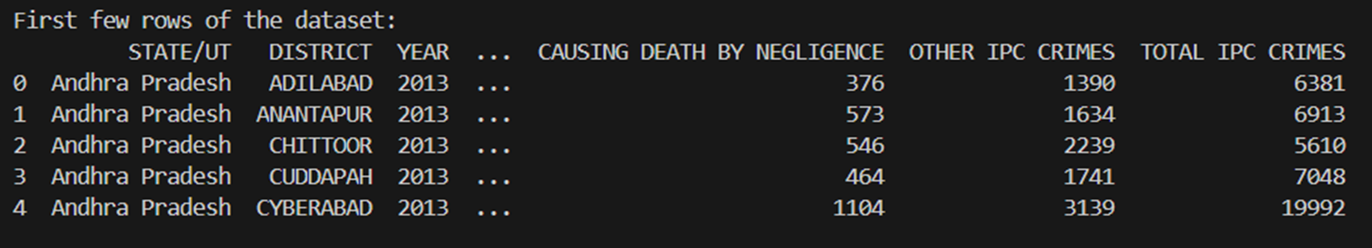
DATASET OVERVIEW
The dataset is structured with the following columns:
State/UT: The name of the state or union territory.
District: The specific district within the state/UT.
Year: The year in which the crimes were recorded.
Crime Types: Various crime categories such as murder, attempt to murder, culpable homicide, kidnapping, rape, robbery, burglary, and more.
For each district, the dataset also includes a total of Indian Penal Code (IPC) crimes, summarizing all the crimes committed in that area. This comprehensive data will serve as the basis for in-depth analysis, hypothesis testing, and correlation analysis to identify patterns, trends, and contributing factors related to crime across India.
9397 Data Points in the Dataset
31 FEATURES

Slide 4
Use the trained model to make predictions on new or unseen data.
Validate predictions with real-world observations if possible.
Generate actionable insights from predictive results.
Understand the dataset’s structure, variables, and types.
Analyze distributions, relationships, and patterns using visualizations and summary statistics.
Detect missing, inconsistent, or anomalous data.
Use geospatial data to explore patterns and trends across locations.
Visualize data on maps (e.g., heatmaps, choropleth maps).
Perform geospatial clustering or proximity analysis.
EDA and Data Cleaning
Inferential Statistics
Geospatial Analysis
Machine Learning
Predictions and Forecasting
Evaluation and Interpretation
Perform hypothesis testing to validate assumptions.
Analyze relationships between variables using correlation and regression techniques.
Evaluate statistical significance of key findings.
Choose appropriate ML algorithms (e.g., classification, regression, clustering).
Split data into training, validation, and test sets.
Train and optimize models using techniques like grid search or cross-validation.
Compare model performance using relevant metrics (e.g., accuracy, RMSE, F1-score).
Assess model accuracy and reliability.
Interpret model outputs and ensure alignment with domain knowledge.
Identify limitations and areas of potential improvement.

Slide 5
EDA AND DATA CLEANING SUMMARY

Slide 6
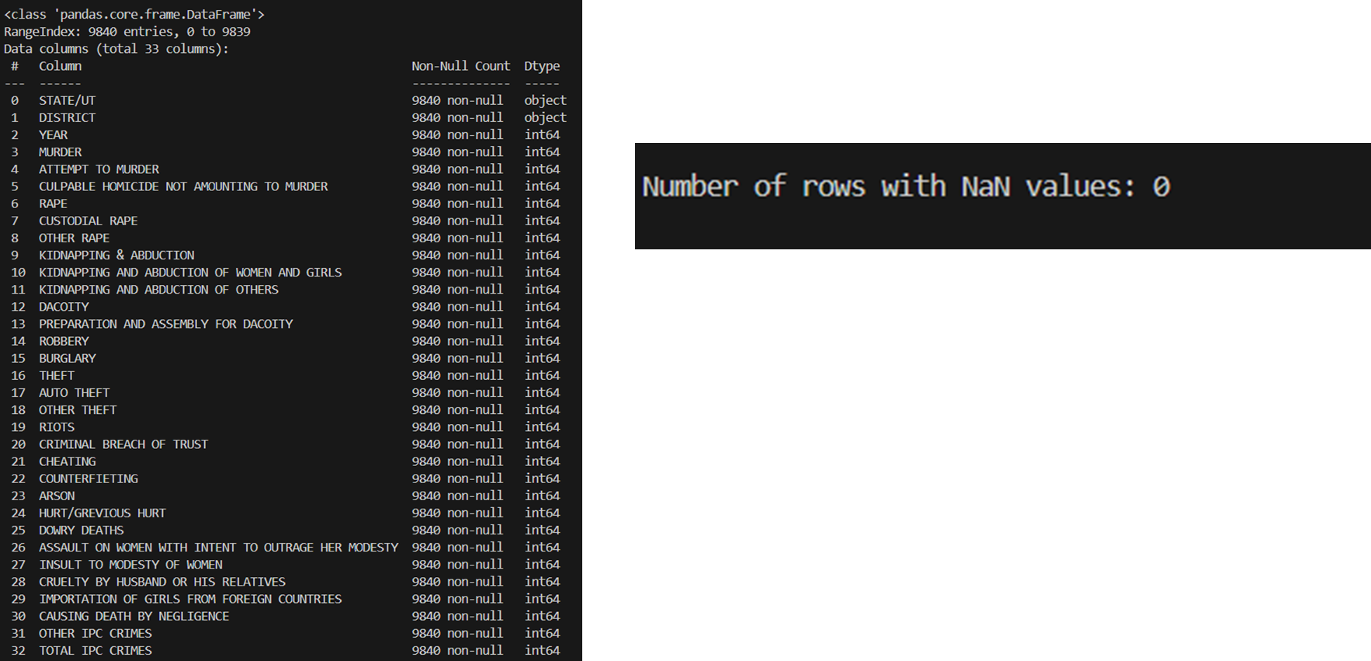
NO NULL VALUES FOUND
NO MISSING OR
GARBAGE VALUES

Slide 7
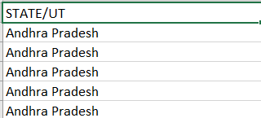
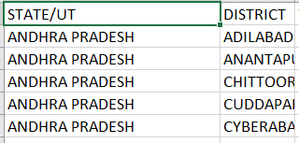
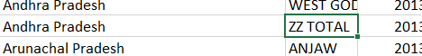
DATA MODIFICATION DONE
State/UT Column: Converted all values to uppercase to standardize the formatting, as many entries were in lowercase or mixed case.
District Column: Removed rows where the district name was "Total" or "ZZ Total," as these entries represented aggregated data for the entire state and were mistakenly included as individual districts.
Final Dataset: The cleaned data was saved in a
new CSV file named crimes_cleaned.csv for
Further analysis.

Slide 8
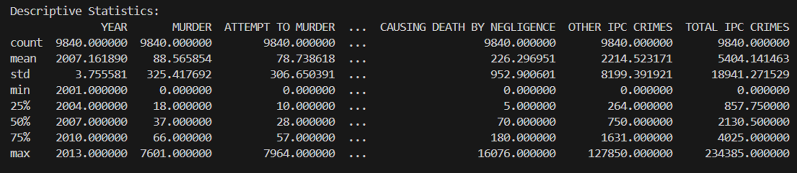
DESCRIPTIVE STATISTICS
In our analysis of crime data, we computed key descriptive statistics, including the count of observations, mean, standard deviation, minimum, 25th percentile, median, 75th percentile, and maximum for each crime type. These statistics provide insights into the average crime levels, variability, and the range of incidents, helping us to understand overall trends and patterns in crime across different regions.

Slide 9
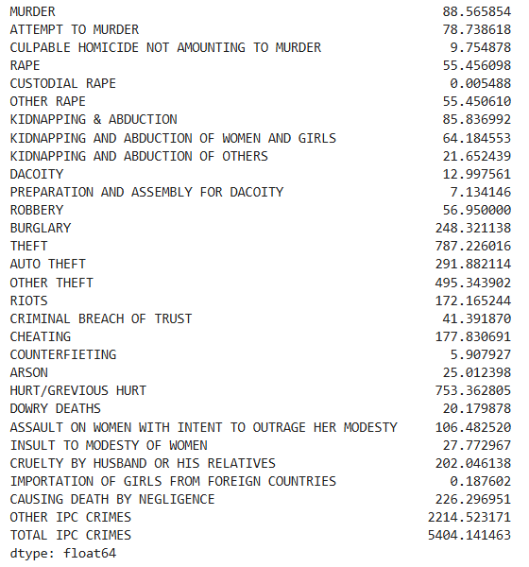
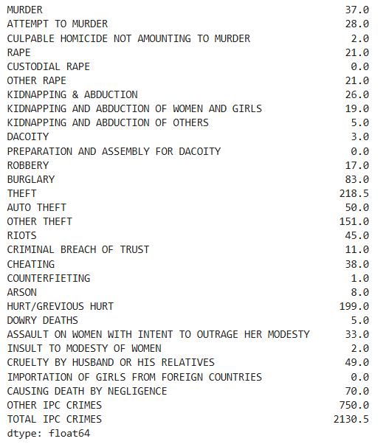
Mean and Medians of all Features

Slide 10
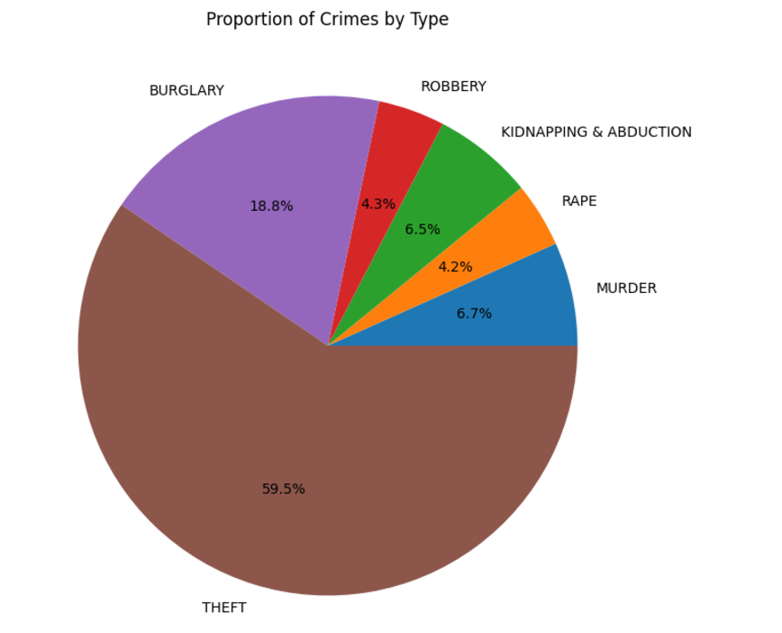
Visualization of Crimes Extent
We can see that Theft Crimes are the highest number of crimes , followed by Burglary and Murder.

Slide 11
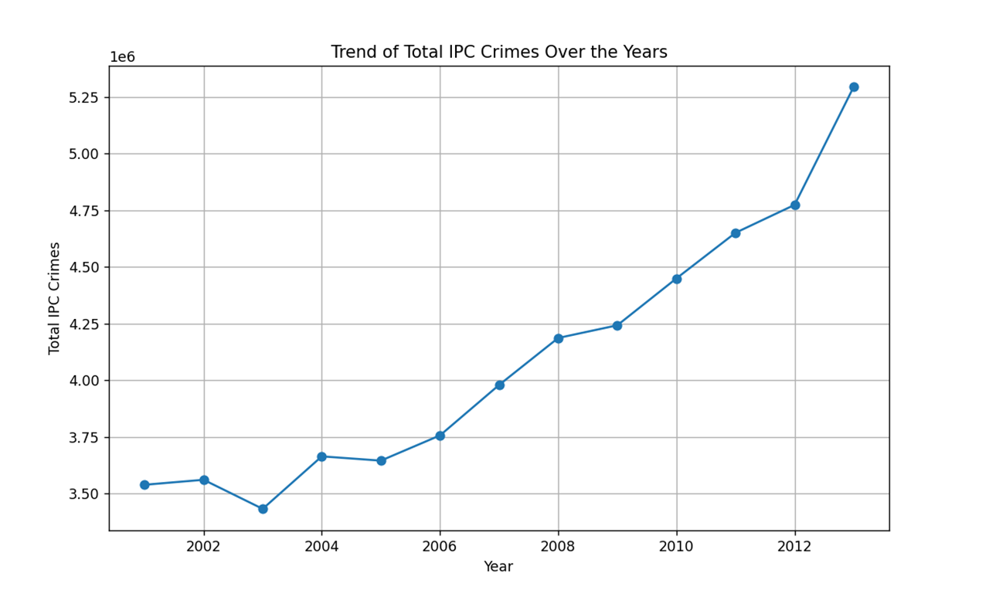
Visualization of Crimes Extent
The Total Number of Crimes
Show an increasing trend over the years.

Slide 12
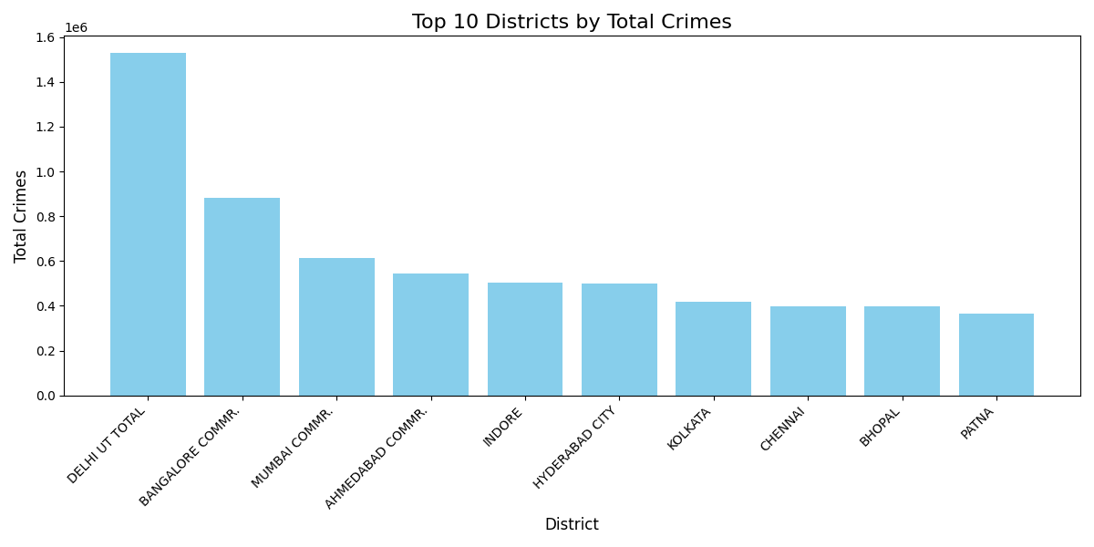
Visualization of Crimes Extent
The highest number of crimes occur in Delhi, followed by Bangalore and Mumbai

Slide 13
RESULTS OF INFERENTIAL STATISTICS

Slide 14
T TEST RESULTS
The aim of the T-test was to determine if there was a significant difference in theft rates between Arunachal Pradesh and all other states combined. This analysis helps evaluate whether Arunachal Pradesh’s theft rates deviate from the national average.
PURPOSE
State: ARUNACHAL PRADESH
t-statistic: -3.6308049443920467
p-value: 0.00028397370074046487
Reject null hypothesis -
Significant difference found between thefts in ARUNACHAL PRADESH and all other states combined
RESULTS

Slide 15
GEOSPATIAL ANALYSIS

Slide 16
Why Geospatial Analysis ?
Geospatial analysis is a critical component of the project, leveraging spatial data to uncover patterns, relationships, and insights that inform decision-making. By integrating geographic information systems (GIS) and advanced mapping techniques, this analysis enables the visualization of project-related data in a spatial context. Key aspects include identifying spatial trends, optimizing resource allocation, and enhancing predictive models. The insights derived from geospatial analysis support more effective planning, improved accuracy, and a deeper understanding of the project’s environmental, social, and economic impacts.

Slide 17
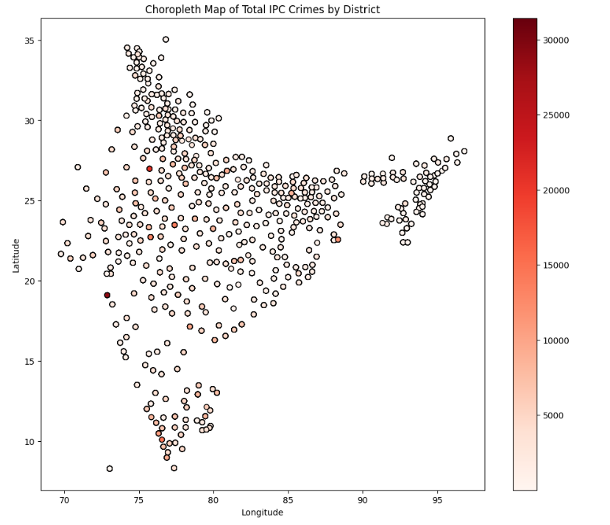
Visualization of Crimes Distribution
The choropleth map provides a visual representation of the total number of crimes distributed across districts, using color gradations to indicate varying crime levels. Darker shades highlight districts with higher crime rates, while lighter shades represent areas with fewer incidents. This map helps identify geographic patterns and hotspots of criminal activity, offering valuable insights for law enforcement and policymakers to target interventions and allocate resources effectively.

Slide 18
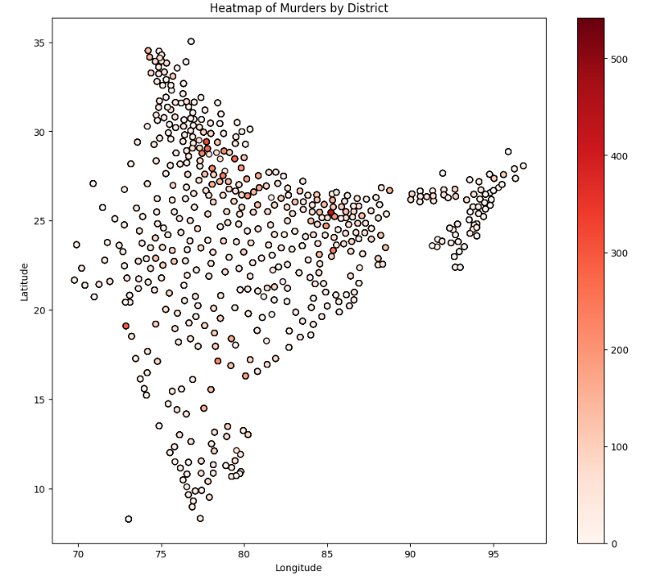
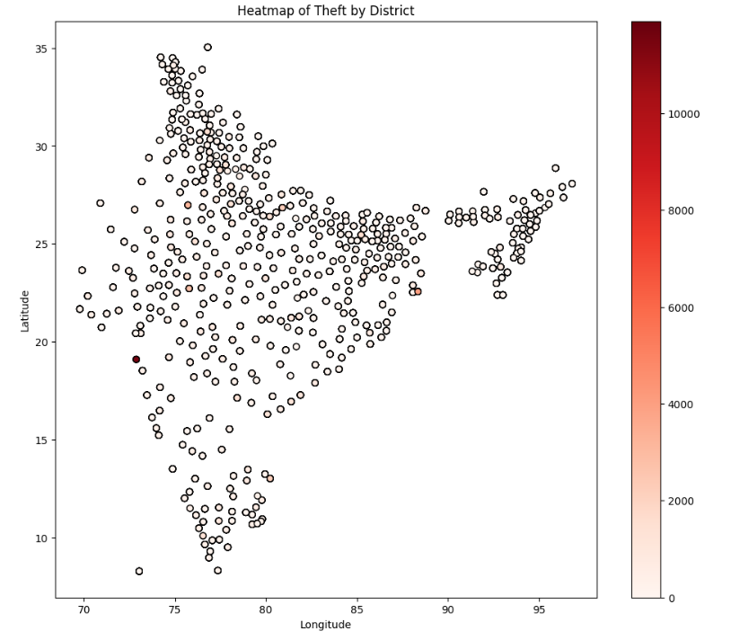
Visualization of Crimes Distribution

Slide 19
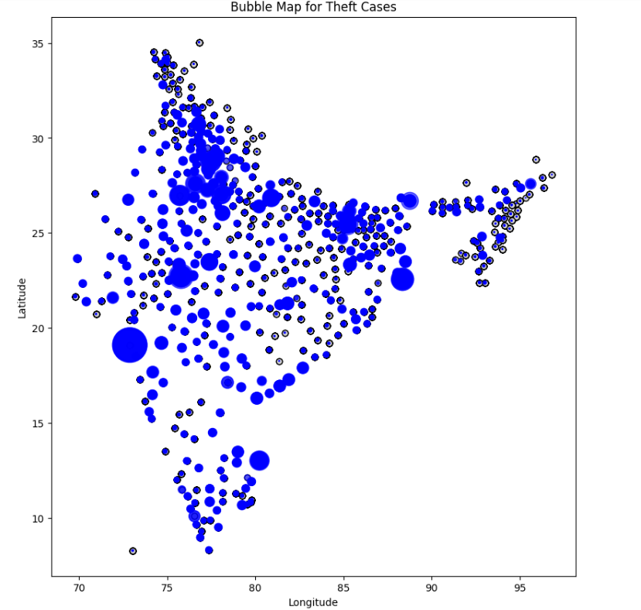
THEFT : BUBBLE MAP
The bubble map offers a dynamic visualization of theft cases across various locations, using bubble size to represent the volume of theft incidents in each area. Larger bubbles indicate areas with higher occurrences of theft, while smaller bubbles highlight regions with fewer cases.

Slide 20
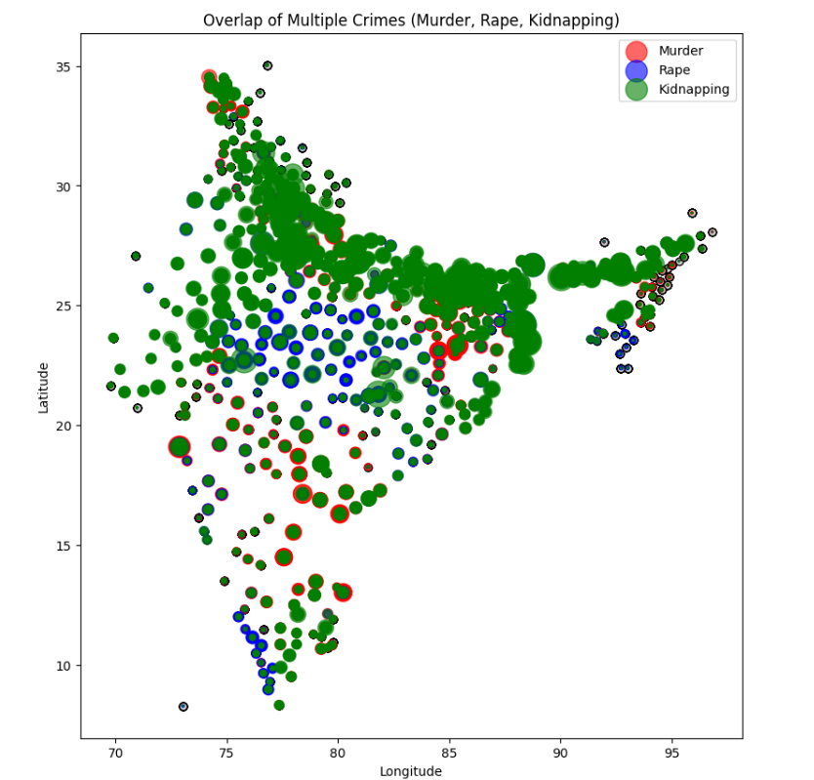
VARIOUS CRIME VISUALIZATION
The map showcasing the overlap of various crimes provides a comprehensive view of how different types of criminal activities coexist and cluster across geographic regions. By layering data on crimes such as murder , rape , kidnapping , the map highlights areas where multiple crimes frequently occur, revealing critical hotspots of criminal activity.

Slide 21
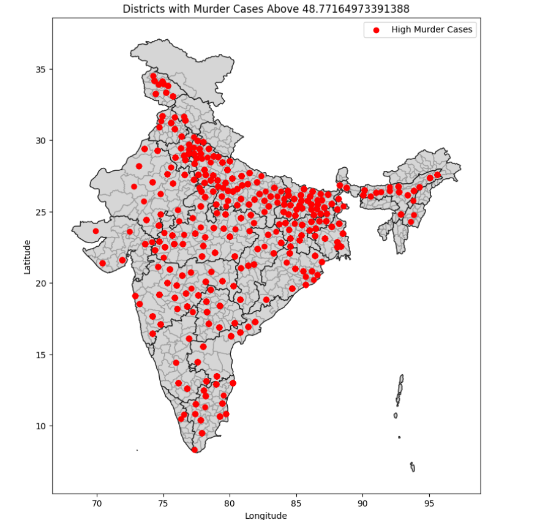
Detection Regions With High Murder Rate
To identify regions with a high murder rate, we calculated the mean number of murder cases across all districts as a threshold. Districts with murder rates exceeding this threshold were classified as high murder zones. This dynamic approach ensures that the analysis adapts to the overall distribution of data, providing a statistically robust method to pinpoint areas with significantly higher crime rates. By focusing on these zones, we can effectively prioritize areas requiring immediate attention and further analysis. The filtered data forms the basis for subsequent clustering and visualization of crime patterns.

Slide 22
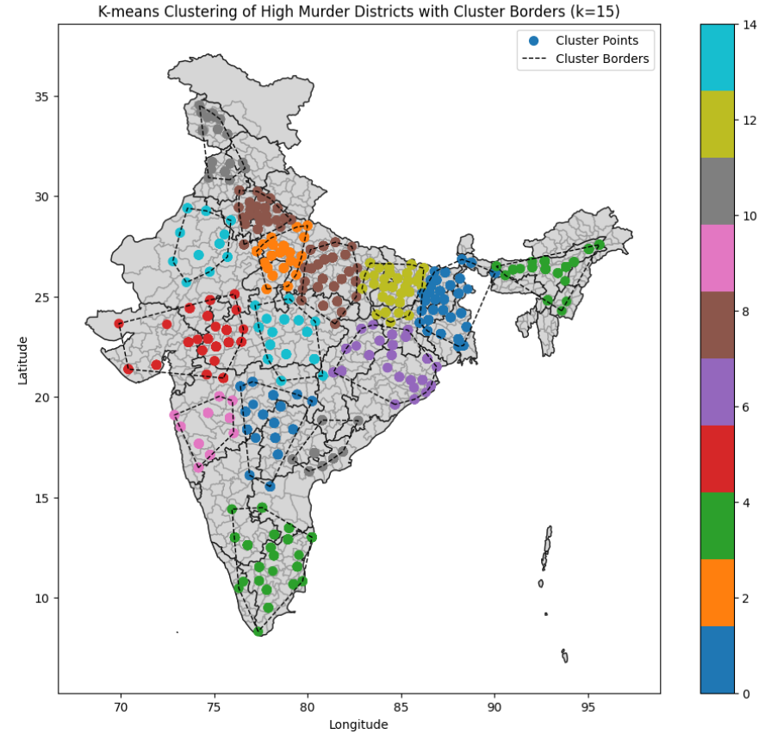
Clustering of Regions With High Murder Rate
To identify geographic patterns in districts with high murder rates, we employed K-means clustering with k=15
Each cluster represents a group of districts with spatial proximity. Using the convex hull method, we outlined the borders of each cluster to highlight their geographical extent. This approach allows for a clear visual representation of crime hotspots, aiding in targeted policy-making and resource allocation. The clusters and their boundaries were visualized on a map, providing insights into regional crime trends.

Slide 23
MACHINE LEARNING MODELS
FOR VARIOUS APPLICATIONS

Slide 24
AIM 1
Linear Regression:
Chosen as a baseline model because Total IPC Crimes is nearly a sum of other features, implying a strong linear relationship.
Ideal for benchmarking as it provides simple, interpretable results.
K-Nearest Neighbors (KNN):
Non-parametric model that captures non-linear relationships between features and the target variable.
Useful for understanding local patterns but can struggle with high-dimensional data.
Gradient Boosting:
Optimizes performance iteratively by focusing on errors of the previous model, leading to higher precision.
Works well for structured tabular data and captures non-linearities.
We aimed to predict the Total Number of Crimes Based on the Different Features Available

Slide 25
RESULTS
Key Observations
Linear Regression performs very well(R² = 0.99), validating the hypothesis of strong linearity.
Gradient Boosting achieves the second best overall performance with the lower MSE and high R², indicating its strength in capturing both linear and subtle non-linear patterns.
KNN shows strong R² but has a higher MSE
Model | MSE | R² | Interpretation
Linear Regression | 1.171 | 0.999 | Almost perfect fit; reflects that Total IPC Crimes is nearly a linear sum of features.
KNN | 98,954.70 | 0.9931 | Strong performance; captures local patterns well.
Gradient Boosting | 65,607.70 | 0.9954 | Best model; balances accuracy and generalization effectively.

Slide 26
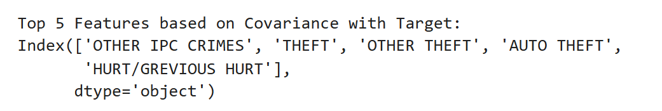
AIM 2
For Aim 2, we use the same models as in Aim 1, but now trained on the top 5 features selected based on their covariance with the target variable (Total IPC Crimes). Here's why these models were chosen:
Linear Regression: Baseline model due to the near-linear relationship between features and Total IPC Crimes, providing simple and interpretable results.
K-Nearest Neighbors (KNN): Captures non-linear relationships and local patterns in data, useful for understanding district-level crime variations.
Gradient Boosting: Iteratively improves predictions, handles non-linearities, and excels in structured data with high precision.
Our aim was Again to Predict the Total Number of Crimes , but this time , we decided to pick the top 5 features only based on the variance covariance matrix.

Slide 27
RESULTS
Key Observations
By reducing the feature set to the top 5 predictors, the models exhibited slightly reduced accuracy compared to training on the full feature set.
This highlights the trade-off between model complexity and interpretability. While the models are less complex and easier to interpret, their predictive performance decreased marginally.
Model | Mean Squared Error (MSE) | R² Score
Linear Regression | 190,860.26 | 0.9867
K-Nearest Neighbors | 157,886.31 | 0.989
Gradient Boosting | 161,932.86 | 0.9887

Slide 28
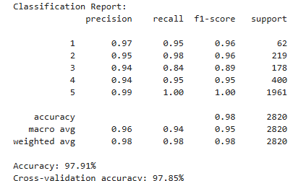
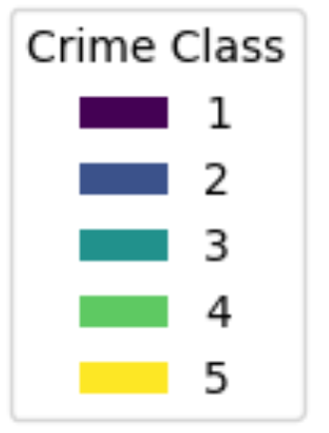
AIM 3
Steps Taken
Feature Creation:
A new feature, TOTAL_CRIMES, was created by summing all crime-related columns for each district.
This consolidated the crime data into a single metric for categorization.
Crime Classification:
Districts were categorized into five crime levels (labeled 1 to 5) using binning:
Level 1: Very low crime
Level 2: Low crime
Level 3: Moderate crime
Level 4: High crime
Level 5: Very high crime
Model Training:
A Random Forest Classifier was trained on the preprocessed data to predict the crime category of each district.The model achieved high accuracy and showed good performance in distinguishing between the five crime levels.
Now our aim was to categorise the different districts based on the record of crimes that had taken place there.

Slide 29
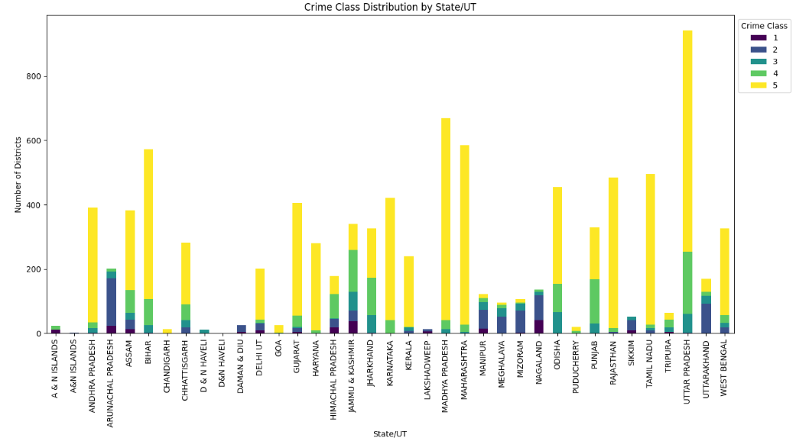
RESULTS
Key Observations
Uttar Pradesh:
Uttar Pradesh has the highest number of Level 5 (highest crime) districts, indicating a significant concentration of crime in certain areas.
This highlights the need for focused crime prevention measures and resource allocation in this state.
Arunachal Pradesh:
Arunachal Pradesh shows the most balanced distribution of districts across all crime levels.
This suggests that crime is more evenly spread, with no extreme concentrations in any category.
Such distribution allows for a more uniform implementation of policies across districts.

Slide 30
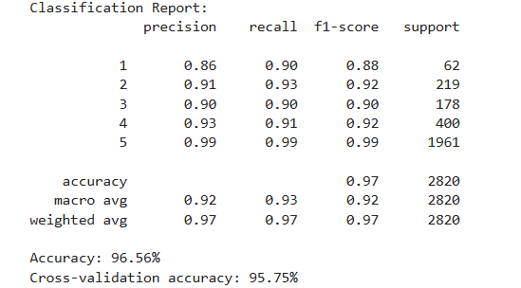
ADD-ON TO AIM 3
We train a Random Forest model to classify crime severity in districts based on selected crime types such as MURDER, THEFT, HURT/GREVIOUS HURT , OTHER IPC CRIMES and KIDNAPPING & ABDUCTION. After preprocessing, the total crime count is calculated, and districts are grouped into five crime severity levels
Model Training:
The model was trained on the preprocessed data to predict the crime category of each district.The model achieved good accuracy and showed good performance in distinguishing between the five crime levels.
Now we tried to find the crime label of a city by using only 6 features.

Slide 31
FUTURE
PREDICTIONS USING
VARIOUS TECHNIQUES

Slide 32
OUR ATTEMPT USING LINEAR REGRESSION , SVR AND OTHER MODELS
In our analysis, we explored various predictive modeling techniques, including Linear Regression, Support Vector Regression (SVR), and other machine learning approaches, to forecast future crime trends. However, the dataset presented a significant challenge: it consisted of only 13 years of data, resulting in just 13 data points per category.
This limited dataset size made it difficult for the models to accurately learn and capture underlying patterns or trends. Consequently, the predictions lacked reliability, underscoring the need for more extensive historical data or alternative methods to derive meaningful insights.

Slide 33
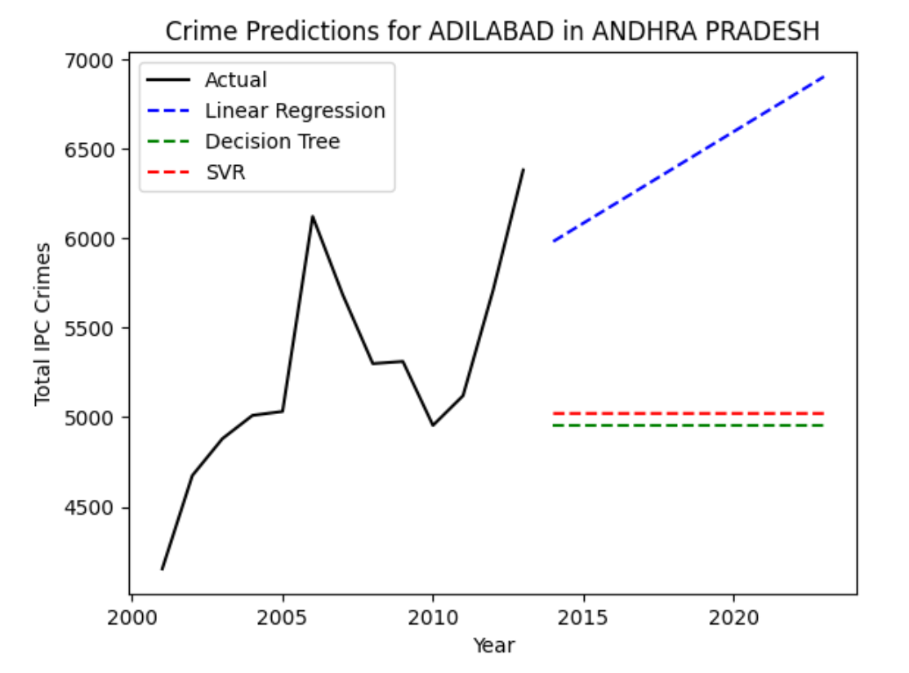
OUR ATTEMPT USING LINEAR REGRESSION , SVR AND OTHER MODELS
The results obtained from our predictive modeling efforts were not particularly insightful. Both Support Vector Regression (SVR) and Decision Tree models failed to produce meaningful predictions, likely due to the small size of the dataset and the complexity of the relationships within the data. While Linear Regression did yield some results, it became evident that assuming a linear relationship for predicting future trends was not appropriate. The inherent complexities and non-linear dynamics of the factors influencing crime patterns suggest that more sophisticated models or a larger dataset may be necessary to achieve accurate and reliable predictions.

Slide 34
WE TRIED A NEW APPROACH : ARIMA AND VAR
In our analysis, we initially focused on classification and regression-based approaches to understand crime patterns and district categorization. However, crime data is inherently time-dependent, with trends and patterns evolving over the years. Recognizing this temporal aspect, we shifted to time-series models, specifically ARIMA (Auto-Regressive Integrated Moving Average) and VAR (Vector Auto-Regression), for deeper insights.
Why ARIMA and VAR?
Time-Dependent Nature of Crime Data:
Crime statistics are often influenced by historical trends and seasonal patterns (e.g., increase during certain months or years).
ARIMA and VAR explicitly incorporate temporal dependencies, making them ideal for predicting future crime rates and identifying underlying patterns.
Predictive Capability:
ARIMA excels in forecasting a single variable (e.g., total crimes in a district) based on its past values.
VAR, on the other hand, handles multiple interdependent variables, such as the relationship between thefts, murders, and riots, providing a better view of crime dynamics.

Slide 35
ARIMA MODEL
Data Preparation
The analysis was performed for a specific state (State 5, selected for demonstration).
Data was aggregated by year, summing the total number of IPC crimes reported each year.
ARIMA Model Setup
AR (AutoRegressive): This part models the relationship between an observation and a specified number of lagged (previous) observations.
I (Integrated): This component involves differencing the time series data to make it stationary, i.e., to remove trends or other non-stationary components.
MA (Moving Average): This component models the relationship between an observation and a residual error from a moving average model applied to lagged observations.
Forecasting was done for 10 future years.

Slide 36
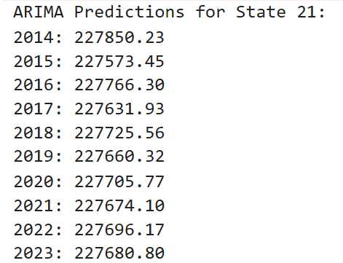
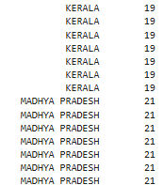
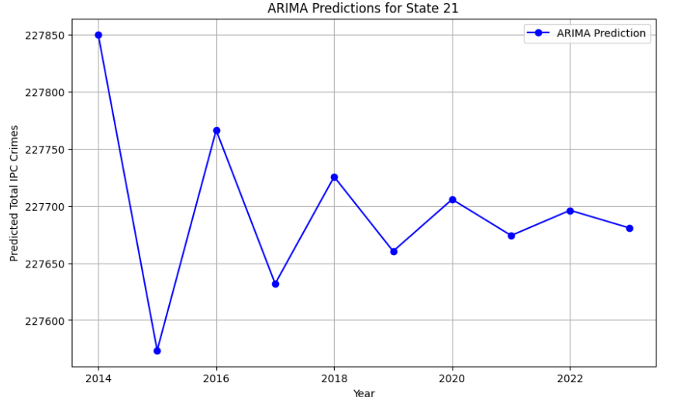
ARIMA MODEL RESULTS
The states have been encoded , Here 21 Represents state of Madhya Pradesh

Slide 37
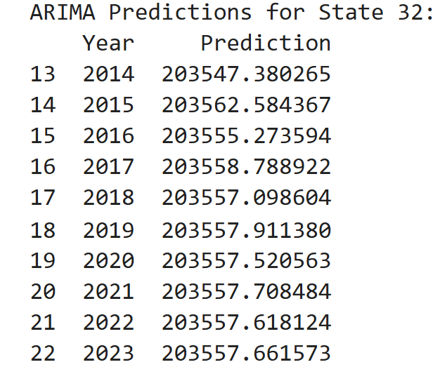
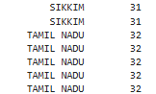
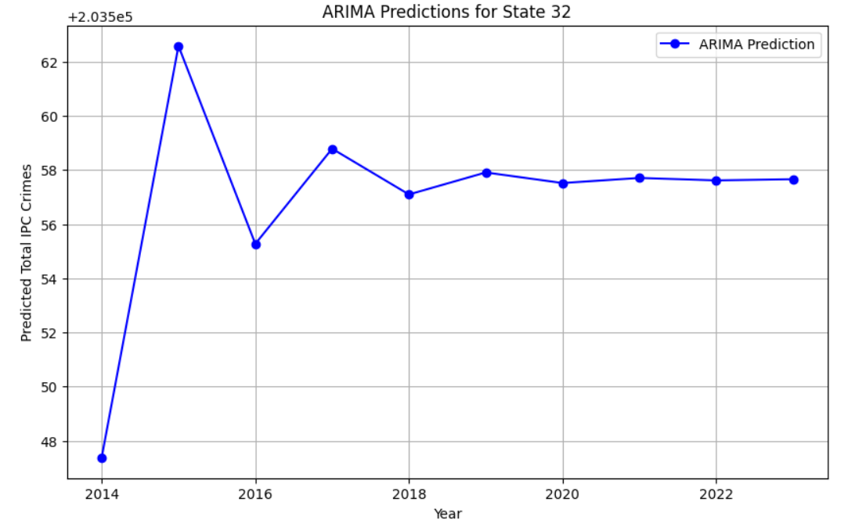
ARIMA MODEL RESULTS
The states have been encoded , Here 32 Represents state of Tamil Nadu

Slide 38
VAR MODEL
Overview of VAR Model
VAR (Vector Auto-Regression) is a statistical model designed for forecasting interdependent time series.
It considers multiple variables simultaneously, capturing relationships and dependencies between them.
Suitable for scenarios where different types of crimes may influence one another, e.g., socio-economic or situational correlations.
Objective
Predict multiple crime categories (e.g., murder, theft, riots) simultaneously for a selected state in India.
Provide a detailed forecast to understand trends in various types of crimes from 2014 to 2023.

Slide 39
VAR MODEL
Data and Model Details
Dataset: Aggregated crime data for the chosen state from 2001 to 2013.
Training Data: Used 13 years of historical data (2001-2013) for building the VAR model.
Forecast Period: Predicted crime counts for 10 years (2014-2023).
Model Configuration:
Max Lags = 1 (adjusted based on data suitability).
Visualization
Combined plot of actual (2001-2013) and forecasted data (2014-2023) for all crime categories.
Highlights:
Clear demarcation of prediction start year (2014).
Variability and correlations between crime categories are evident.

Slide 40
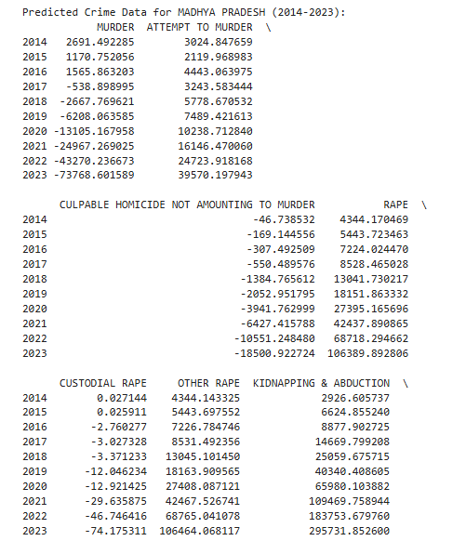
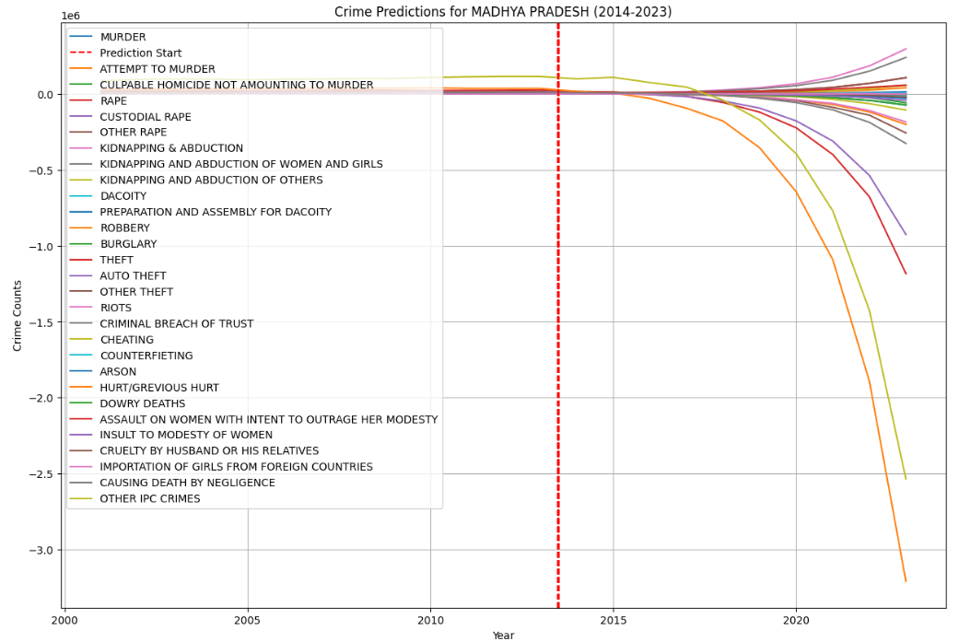
VAR MODEL RESULTS
State Chosen : Madhya Pradesh

Slide 41
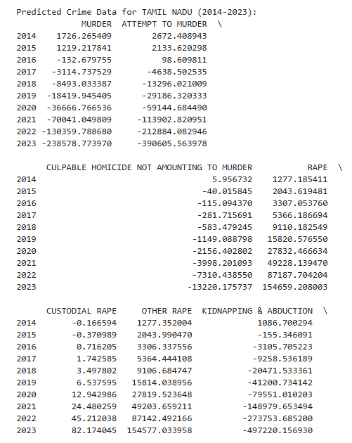
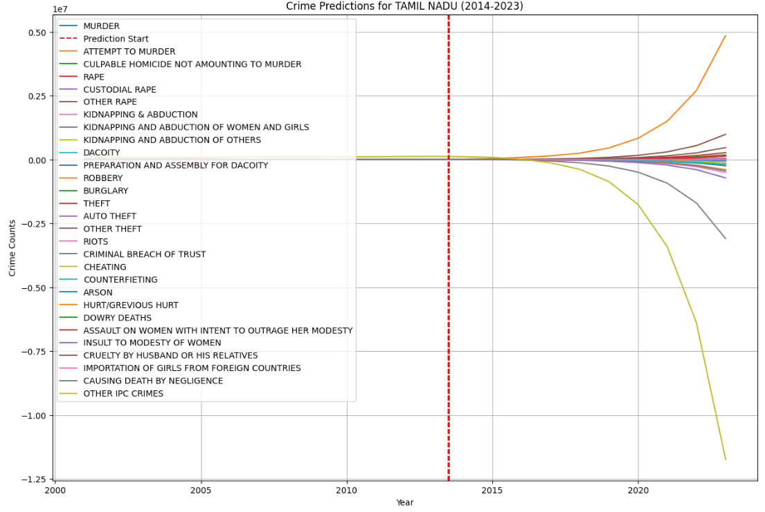
VAR MODEL RESULTS
State Chosen : Tamil Nadu

Slide 42
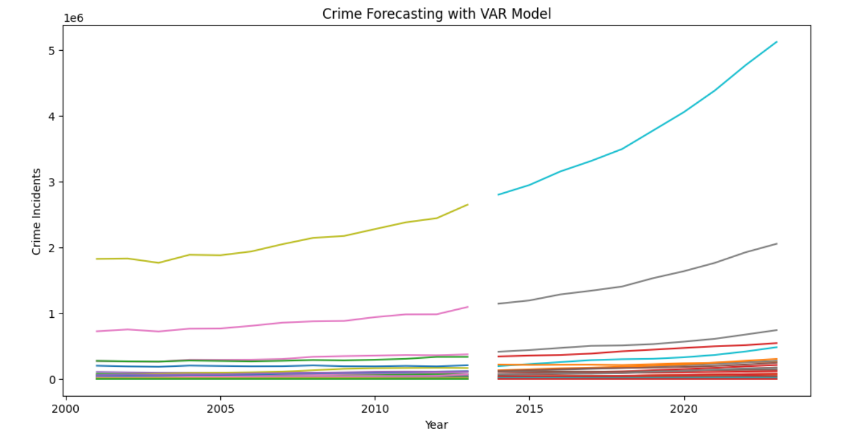
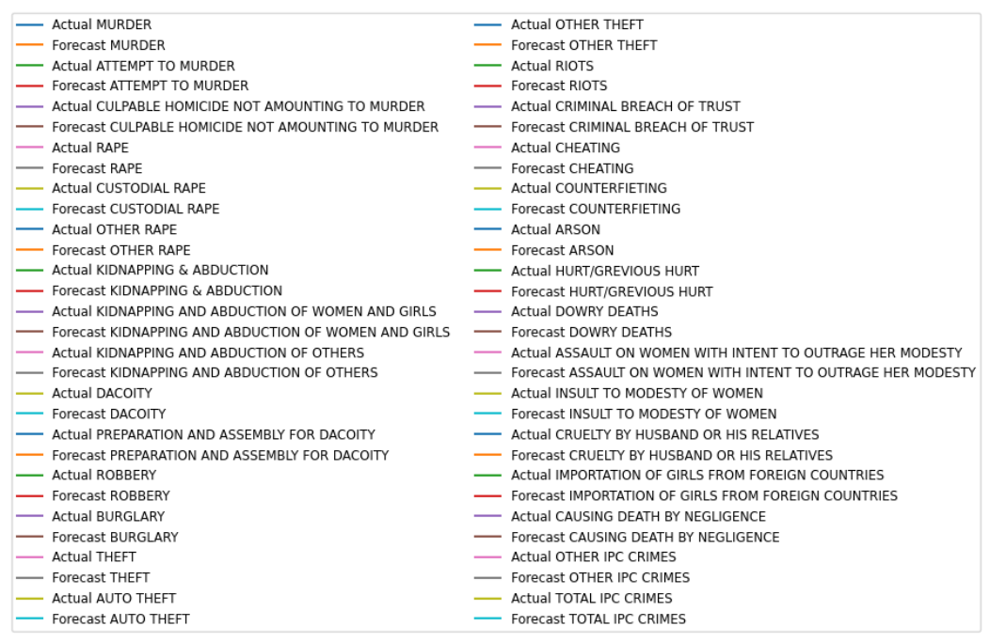
VAR MODEL : FOR THE ENTIRE COUNTRY

Slide 43
RESULTS
AND CONCLUSIONS

Slide 44
OVERVIEW OF RESULTS
Statistical Analysis:
Crime Trends: We identified an increasing trend in total crimes over the years, with some categories (like theft and assault) showing significant growth.
State-Wise Distribution:
Uttar Pradesh reported the highest number of Level 5 (highest crime) districts.
Arunachal Pradesh exhibited the most balanced distribution across all crime levels.
Geospatial Analysis:
Hotspots: Crime hotspots were identified in urbanized and industrialized areas, reflecting socio-economic factors like population density and resource availability.
Spatial Correlation: Neighboring districts often showed similar crime patterns, suggesting spillover effects or shared socio-economic challenges.
Prediction Models:
Regression-Based Analysis:
Linear regression performed best for predicting total crimes, achieving near-perfect accuracy due to the additive nature of the data.
Classification Models:
Random Forest and Gradient Boosting effectively classified districts into crime levels, with high accuracy and interpretability.

Slide 45
CONCLUSION AND INSIGHTS
Crime Pattern Analysis:
Statistical and geospatial methods provided a detailed understanding of how crime varies across states, districts, and years.
Significant socio-economic factors and regional disparities in crime were observed.
Machine Learning Predictions:
Regression models (Linear, KNN, Gradient Boosting) successfully predicted crime rates, offering a reliable way to anticipate trends and allocate resources.
Classification models effectively categorized districts, providing actionable insights for crime prioritization.
ARIMA and VAR for Time-Series:
Time-series analysis revealed temporal trends, seasonality, and interdependencies between crime categories, highlighting their potential for long-term crime forecasting.
Trade-Off Between Complexity and Accuracy:
Feature engineering reduced model complexity but came at a slight cost to prediction accuracy, highlighting the need for balanced approaches in real-world applications.

Slide 46
POLICY RECOMMENDATIONS
Focused Interventions:
Increase Police Presence: Allocate additional law enforcement resources to districts classified as Level 5, especially in Uttar Pradesh and Bihar.
Crime Hotspot Monitoring: Leverage geospatial crime hotspot maps to prioritize surveillance and patrolling in high-crime areas.
Education and Awareness:
Community Awareness Campaigns: Organize local awareness programs to educate citizens on crime prevention and legal rights.
School and Youth Engagement: Incorporate crime awareness modules in school curricula to nurture a culture of lawfulness and respect.
Technology and Infrastructure:
Smart Policing: Deploy advanced technologies like facial recognition, predictive policing tools, and real-time surveillance systems in high-crime zones.
Automated Reporting Systems: Implement online platforms and apps for citizens to report crimes quickly and anonymously.
Cross-State Learning:
Adopt Best Practices: Learn from states like Tamil Nadu, which show a declining trend in crime, possibly due to robust education, employment opportunities, and proactive policing.
Policy Sharing: Facilitate inter-state collaboration to replicate successful programs and policies.

Slide 47
POLICY RECOMMENDATIONS
Sustaining Progress:
Monitor Trends: Regularly analyze crime patterns to ensure continued decline in states like Tamil Nadu and Himachal Pradesh.
Recognition Programs: Acknowledge and reward districts with consistent crime reduction to motivate stakeholders.
Focus on Preventive Measures:
Strengthen Education Systems: Increase investment in education, focusing on literacy and vocational training to address root causes of crime.
Economic Empowerment: Boost employment opportunities, especially for youth, to reduce socio-economic triggers for crime.
Technology Integration:
Data-Driven Governance: Use crime forecasting models to allocate resources effectively and prevent potential spikes in crime.
Surveillance Networks: Expand the use of CCTVs and integrate them into centralized monitoring systems for rapid response.
Public Participation:
Community Policing: Foster trust between law enforcement and communities by involving citizens in neighborhood watch programs.
Social Media Engagement: Use social media platforms to spread awareness, report crimes, and engage with the public in real-time.

Slide 48
TEAM MEMBERS
Mrunal Pravin Kulkarni (22183)
Darshana Srivathsan (22001)
Prakash Kumbhakar (22241)

Slide 49
THANK YOU

